Slide 1
ROCK Complex Case Discussion
13 yo female with 2 year history of left knee pain. She had previous surgery by an outside physician for a large medial femoral condyle OCD lesion. This failed attempted fixation and microfracture was done in October of 2012.

Slide 2
13 yo female presented to an outside community sports medicine physician initially in early 2012
MRI done in April 2012
Large medial femoral condyle OCD lesion
Underwent arthroscopy by outside surgeon in October 2012
Found to be unstable with multiple additional loose bodies
Main fragment underwent attempted fixation with LactoNail. Broken nail and fragmentation of the progeny fragment lead to removal and microfracture of the donor site

Slide 3
Initial MRI

Slide 4
Initial MRI

Slide 5
Initial MRI

Slide 6
Outside Facility Arthroscopy Images

Slide 7
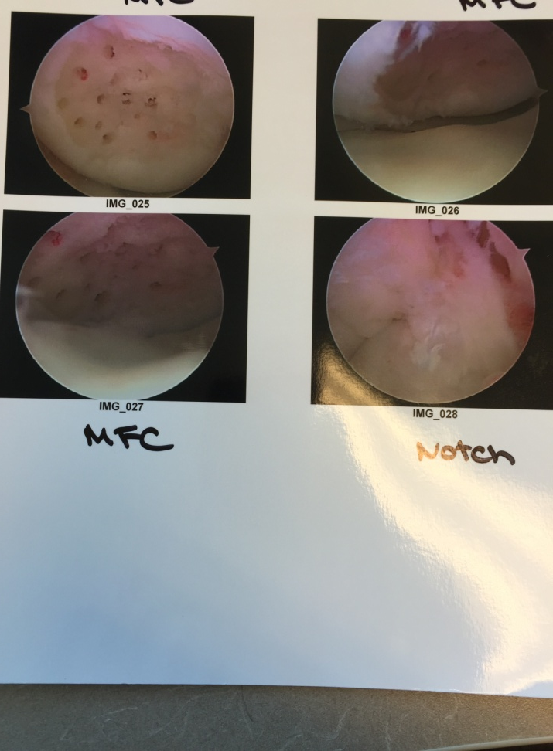
Outside Facility Arthroscopy Images

Slide 8
She was referred to CCMC initially in October 2012 (immediate post operative from the outside physician)
She was managed conservatively initially and recovered well after this first surgery with full motion and return to activities
She was lost to follow up for about 18 months but then returned with daily pain and swelling. No mechanical symptoms at this time.
Repeat MRI done at that time.
Surgical options discussed. Given the size of the lesion, an osteochondral allograft was obtain and placed in May 2014
She did well postoperatively and was advanced to full weightbearing at 8 weeks postoperatively.
No pain or swelling was noted at most recent follow up.

Slide 9
October 2012 initial films at CCMC

Slide 10
October 2012 initial films at CCMC

Slide 11
Follow up MRI in March 2014

Slide 12
Follow up MRI in March 2014

Slide 13
Repeat Arthroscopy at CCMC

Slide 14
Open Images of MFC lesion before and after socket drilling

Slide 15
Final Images of 25 mm diameter MTF medial femoral condyle allograft

Slide 16
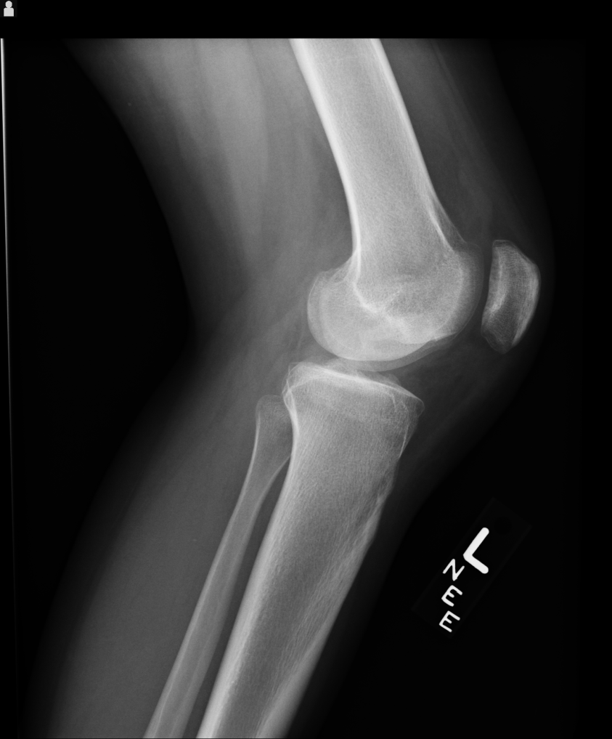
8 weeks post operative films

