Slide 1
ROCK Complex Case of the Month
Dr. Saluan

Slide 2
20 yr. old male
L knee pain + 2 yrs
No specific injury date
Soccer player
MRI that revealed a MFC OCD and loose body
PMH ACL tear

Slide 3
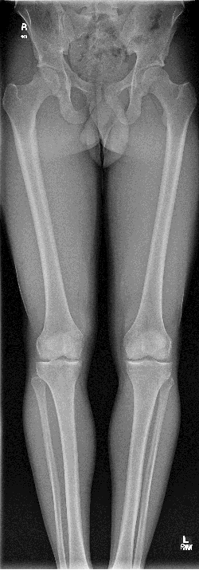
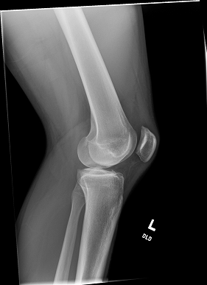
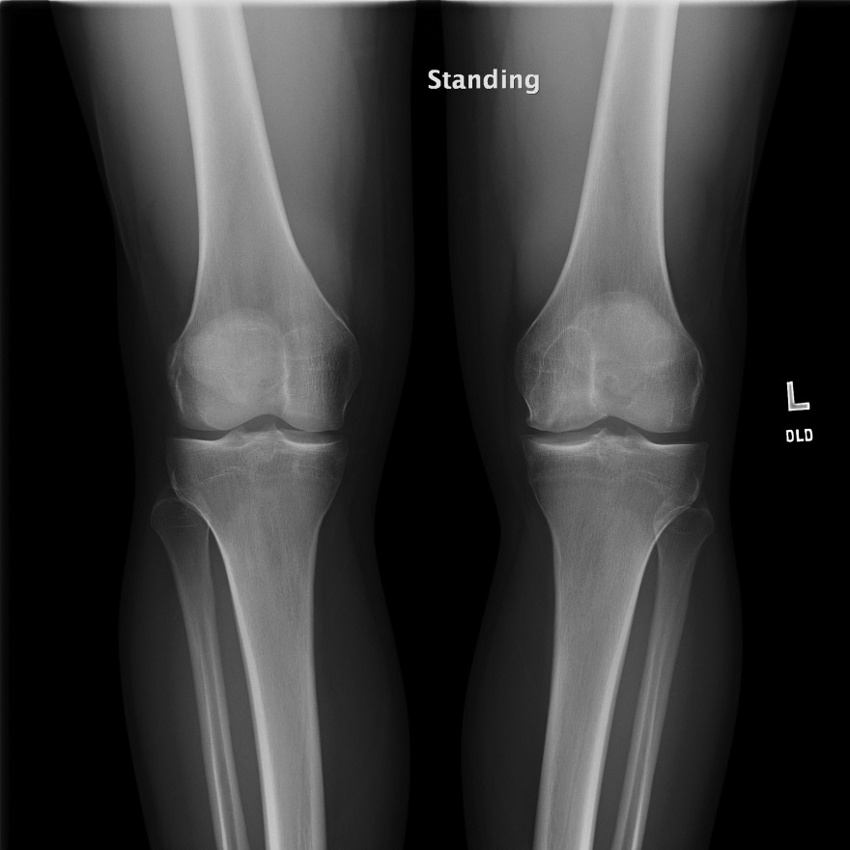
Pre-OP Images

Slide 4
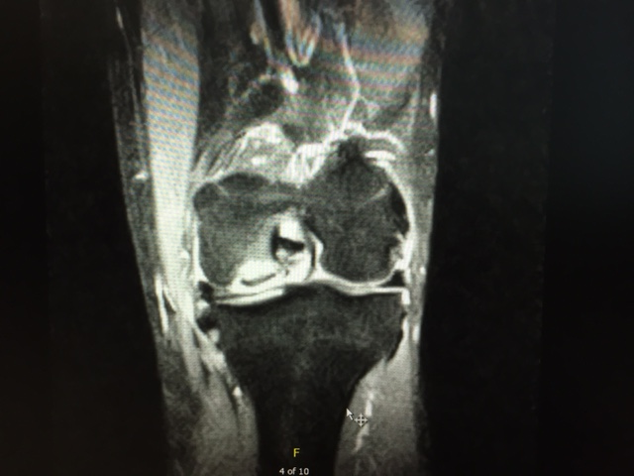

Slide 5
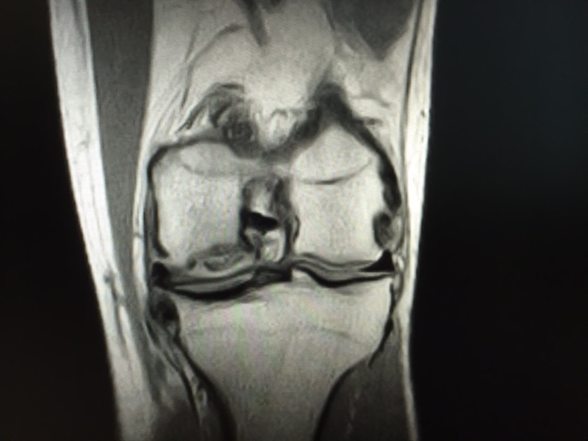

Slide 6
Surgical Images Arthroscopy with partial medial meniscectomy and removal of loose bodies 20 MM OSTEOCHONDRAL ALLOGRAFT TRANSPLANTATION

Slide 7
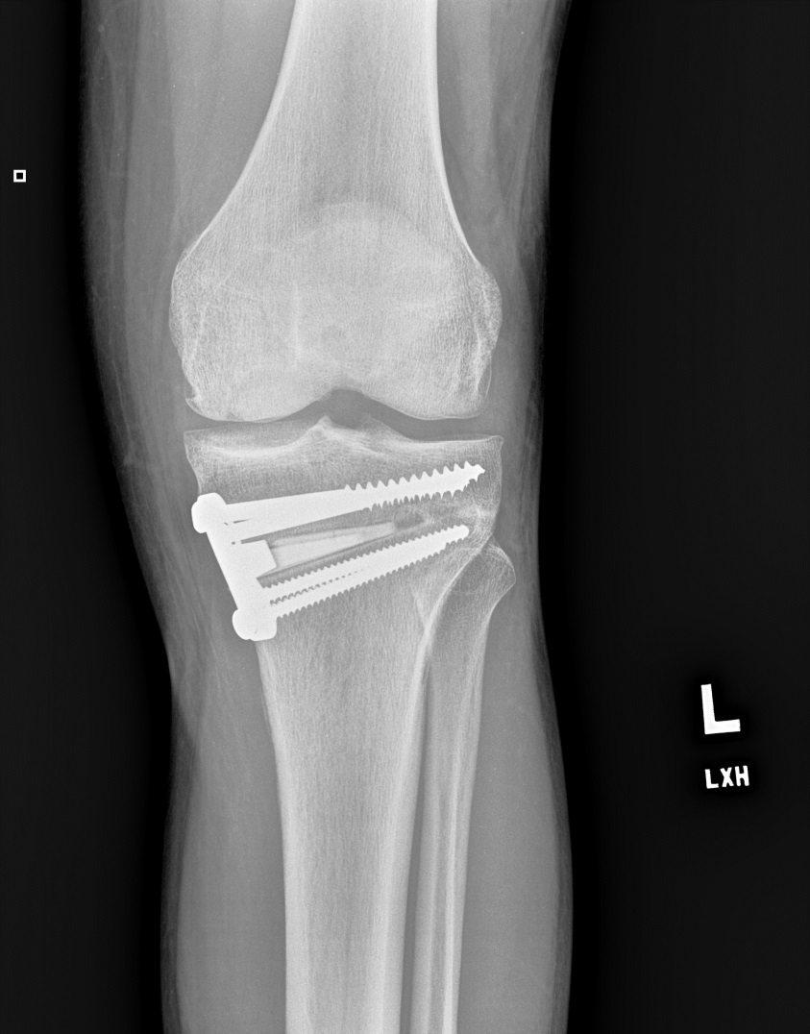
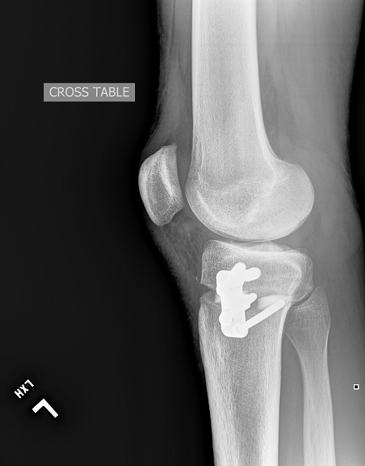
Post OP

Slide 8
Follow up
No pain 2 mo postop
Start weight bearing with the help of crutches
X-rays reveal that he has adequate alignment of his leg and placement of the osteochondral allograft

