Slide 1
ROCK Case of the Month
March 2017

Slide 2
History
14 yo M
Initially presented with left knee pain when jumping, no known injury
Large left medial femoral condyle OCD lesion
Underwent knee arthroscopy, retroarticular drilling with BMAC in Aug 2016
4 months post-op has occasional pain
Wears unloader knee brace
PMHx: Severe dilated cardiomyopathy as an infant and placed in hospice. Survived and subsequently had a pacemaker (not MRI safe) which is still in place, but non-functioning. Family prefers not to have the pacer removed
Miracle survivor plays lacrosse @ elite national high school level
Now, clinically depressed due to activity restrictions

Slide 3
Physical Exam
Well healed incisions
No effusion
Full ROM
No tenderness
2.5cm LLD left < right
Neutral alignment

Slide 4
Pre-op radiographs – Aug 2016

Slide 5
CT Pre-op – Aug 2016

Slide 6
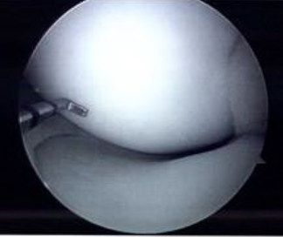
Intra-operative views – Aug 2016 (unable to delineate OCD lesion)

Slide 7
X-rays 4 months post-op

Slide 8
CT scan 4 months post-op

Slide 9
Recommendations @ 4 months post-op?
Observe
Continue activity recommendations & unloader brace
Other non-op treatments?
Repeat Retroarticular drilling with/without BMAC
Trans-articular drilling
Arthroscopic screw fixation
Which fragments? How many screws? What sort?
Bone grafting
Technique? Graft? Fixation?
Realignment procedure
Right LE epiphysiodesis
Vitamin D, hyperbaric oxygen, trip to Lourdes
Other

